Slide 1

EBN122 – Practical 2
NI-ELVIS : Supplementary Slides
By Dieter Barnard
dieter.barnard@up.ac.za
EBN122
Friday, 26 August 2011

Slide 2


IMPORTANT STEPS TO FOLLOW
Turn on system power.
2. Ensure the prototype board power is off
3. Construct the circuit
4. Connect input device
5. Connect output measurement devices
6. Turn on prototype board power
7. Launch the SFP to activate the inputs and outputs

Slide 3
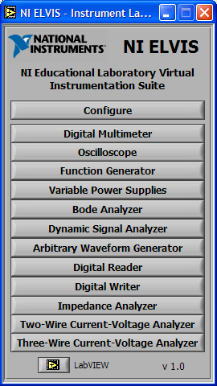
NI-ELVIS
Only these 4 SFP instruments
are used in the EBN122 practicum

Slide 4
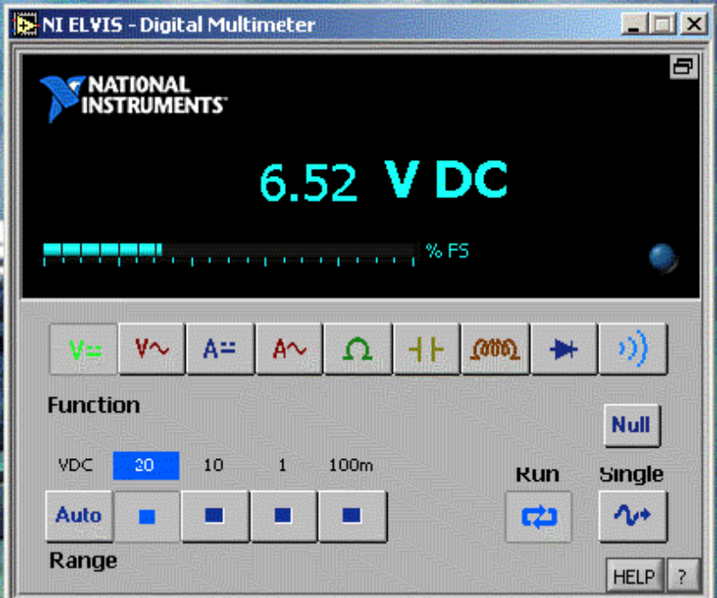
DIGITAL MULTIMETER (DMM)
Measure Voltage (DC)
NULL FEATURE NB!!!!!
Measure Current (DC)
Measure Resistance

Slide 5
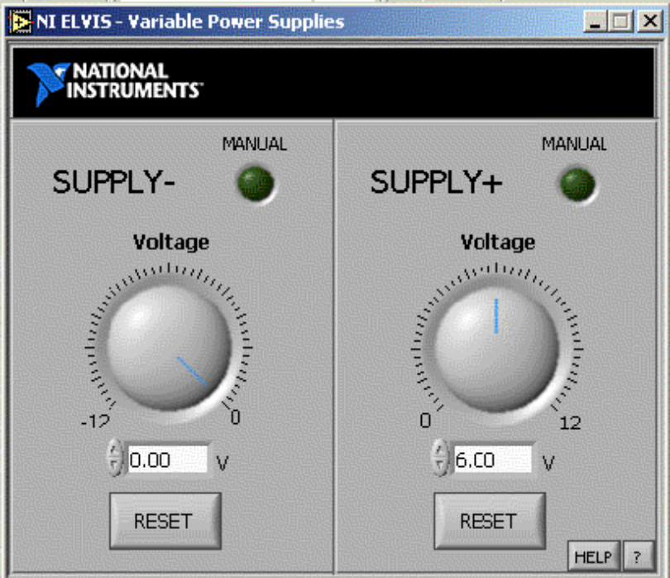
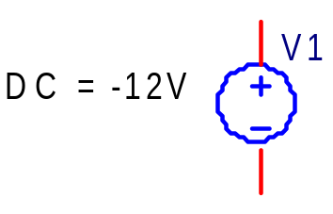
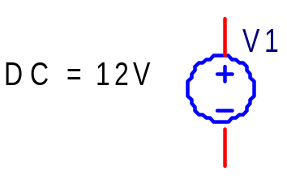
VARIABLE POWER SUPPLY
Negative Supply Voltage(DC)
Positive Supply Voltage(DC)

Slide 6
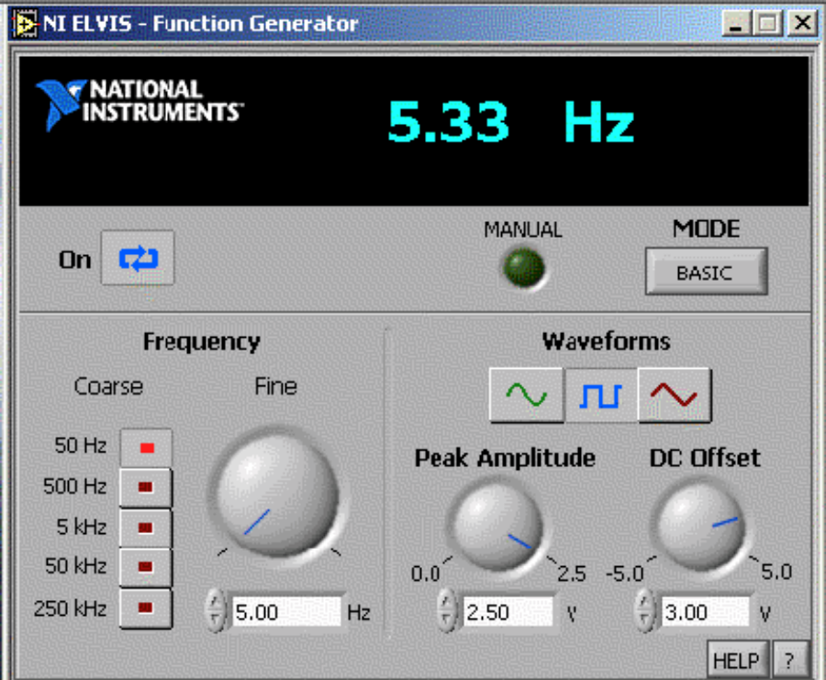
FUNCTION GENERATOR
Select
Sine wave,
Square wave, or
Triangular wave

Slide 7
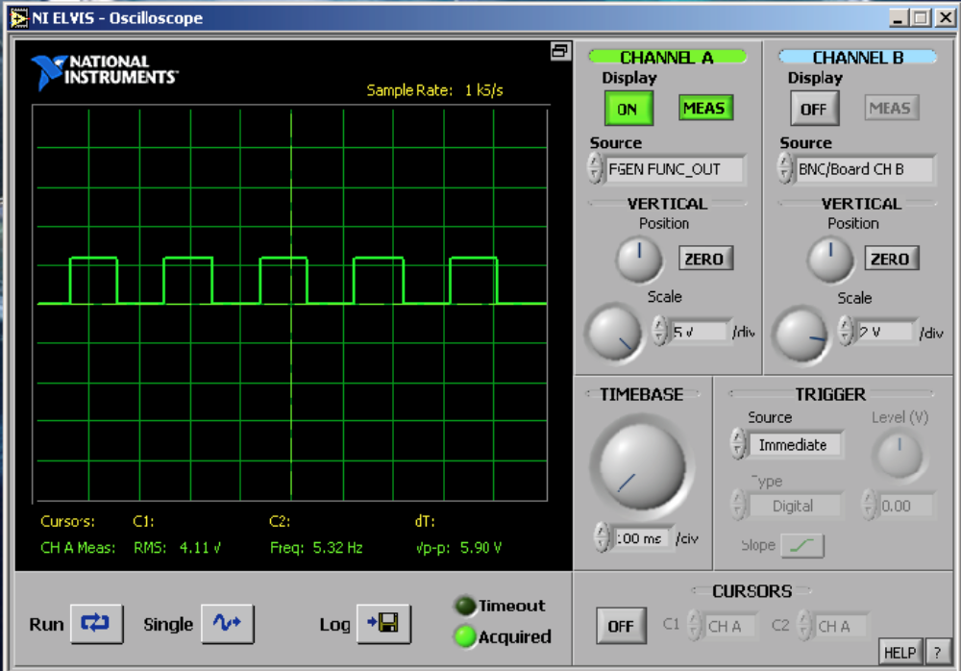
OSCILLOSCOPE
Measure frequency of signal
Measure peak-to-peak voltage
Scale the graph

Slide 8
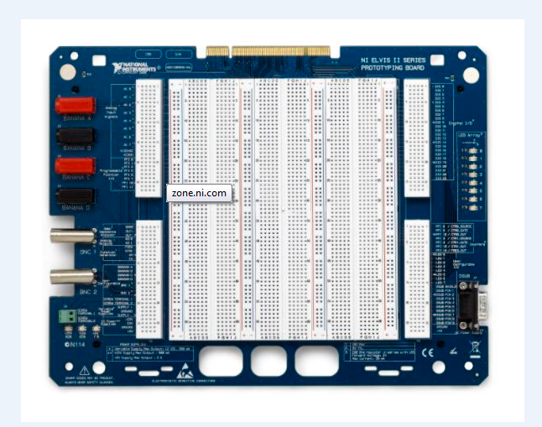
PROTOTYPING BOARD

Slide 9
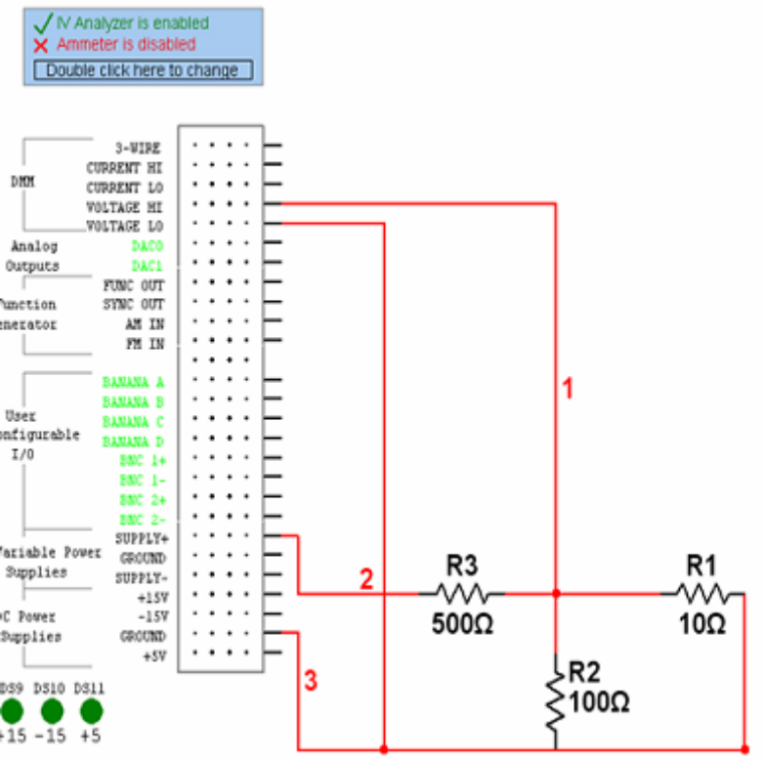
SAMPLE QUESTION
1) Voltage HI of DMM
2) SUPPLY + of variable power supply
3) Ground / Voltage LO of DMM
Note VOLTAGE Hi and VOLTAGE LO are used in order to measure voltage with DMM

Slide 10
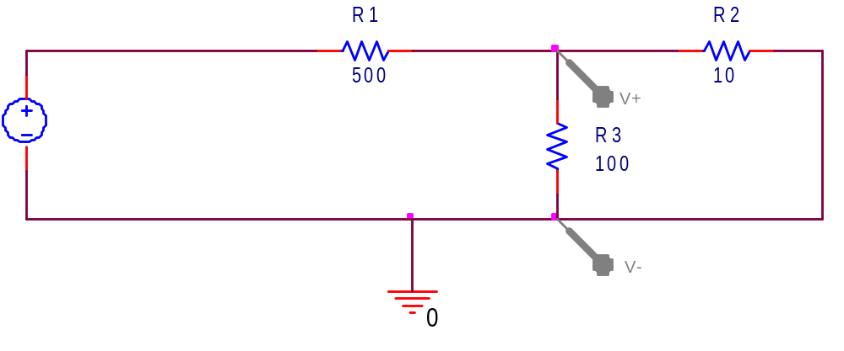
EQUIVALENT CIRCUIT

Slide 11
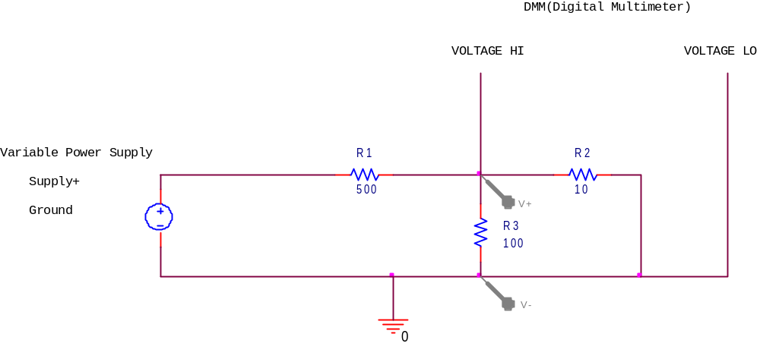
EQUIVALENT CIRCUIT (2)
After connecting circuit correctly and starting NI-ELVIS. The DMM will display the voltage across resistor R3

Slide 12
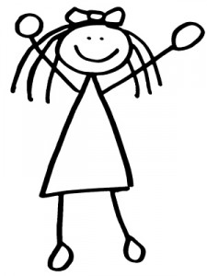
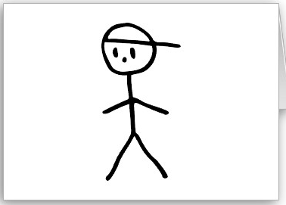
NULL FUNCTIONALITY
Boyfriend wants to know how much his girlfriend weighs (he is a dorky engineer!)
Girlfriend is too shy!

Slide 13

NULL FUNCTIONALITY CTD...
Boyfriend tricks girlfriend by climbing on a scale with her
125 kg
He knows he weighs 70 kg... How does he calculate the girlfriend’s weight???

Slide 14
NULL FUNCTIONALITY CTD...
HE USES THE NULL FUNCTION LIKE ON THE NI-ELVIS BOARD!!!!
Total Weight : 125 kg
Subtract Boyfriend’s weight : -70 kg
--------
Girlfriend’s weight: 55 kg
Similarly, if the Voltage on the digital multi-meter reads between 100-600 mV (due to noise) when it should be reading 0 V. The noise voltage should be NULLED!!!
Do this by pressing the NULL button on the DMM display!!

Slide 15

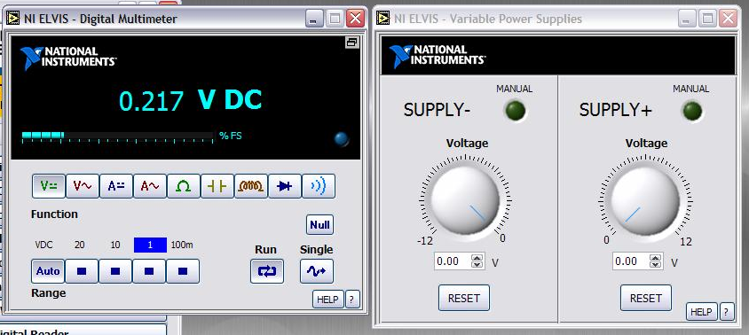
NULL EXAMPLE
Should be 0 V but is not.

Slide 16
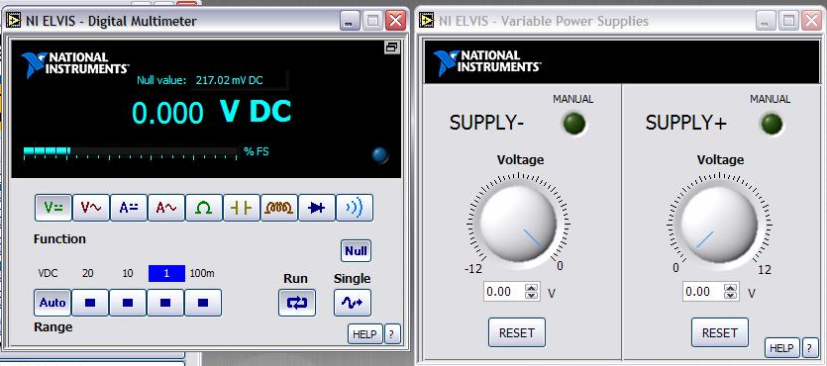
NULL EXAMPLE
After clicking Null, the value is now correct

Slide 17
EMAIL 101
Always start an email with a greeting:
Dear Prof Joubert,
Dear Mr Badenhorst,
Dear Miss Freislich,
Geagte Prof. Joubert,
Geagte Mr. Badenjhorst
Geagte Me. Freislich,
Always finish an email off appropriately:
Regards
Dieter Barnard
Groete
Dieter Barnard

Slide 18
EMAIL 101 CTD...
Always use full sentences
Don’t use SMS language
Take note of grammar and spelling
  Use capital letter at the start of sentences.
  Make use of paragraphs
  A badly written email puts the reader in a bad mood!

